Slide 1


Slide 2
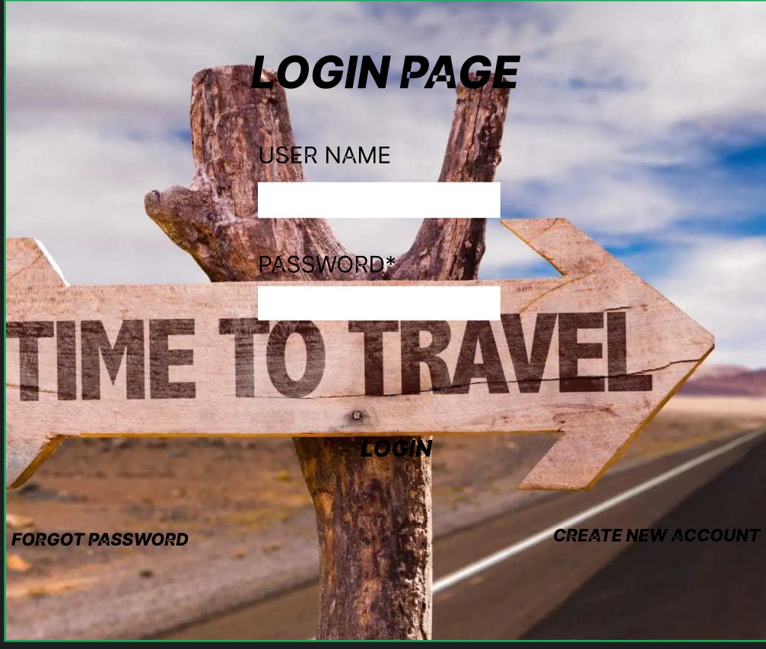

Slide 3


Slide 4
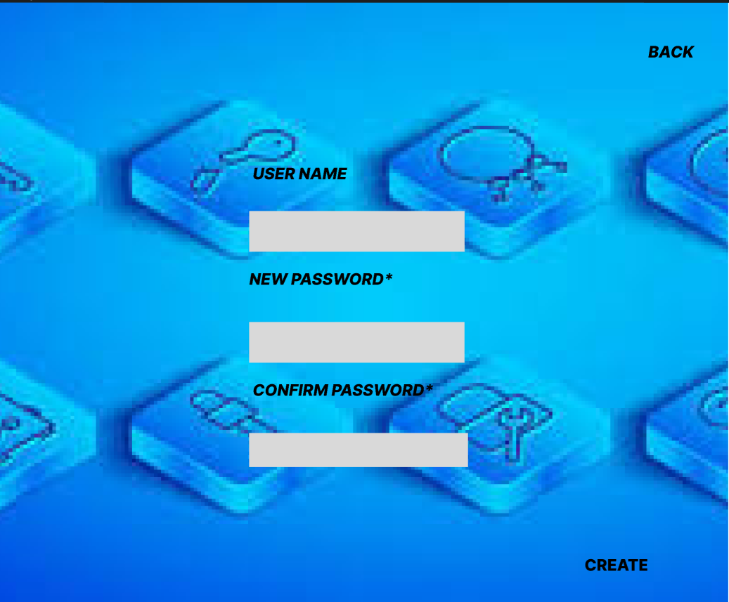

Slide 5


Slide 6


Slide 7
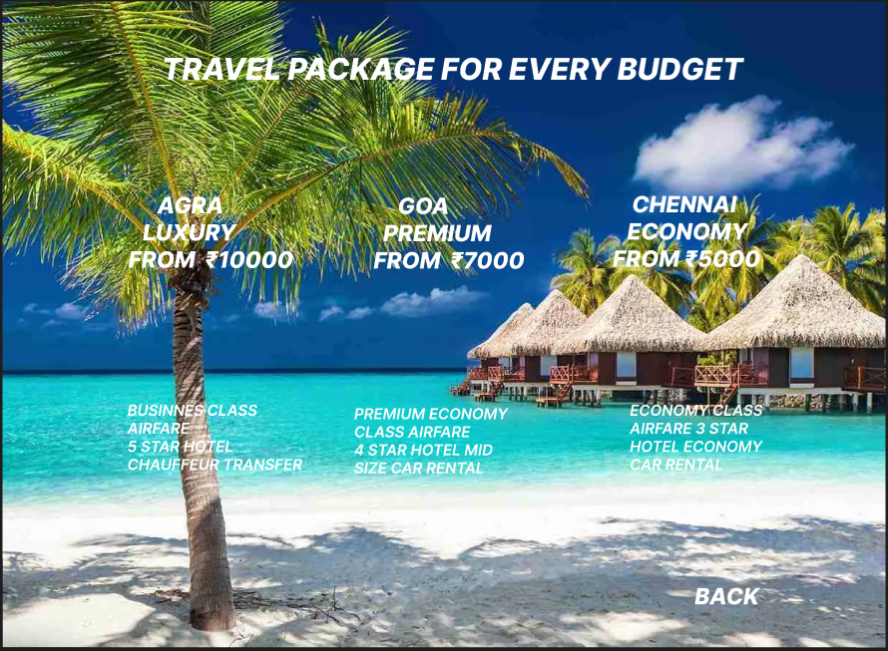

Slide 8
LINK
FIGMA
https://www.figma.com/file/2NqUni6Lacki06Xefe1aFV/Untitled?node-id=0%3A1

Slide 9


